Slide 1
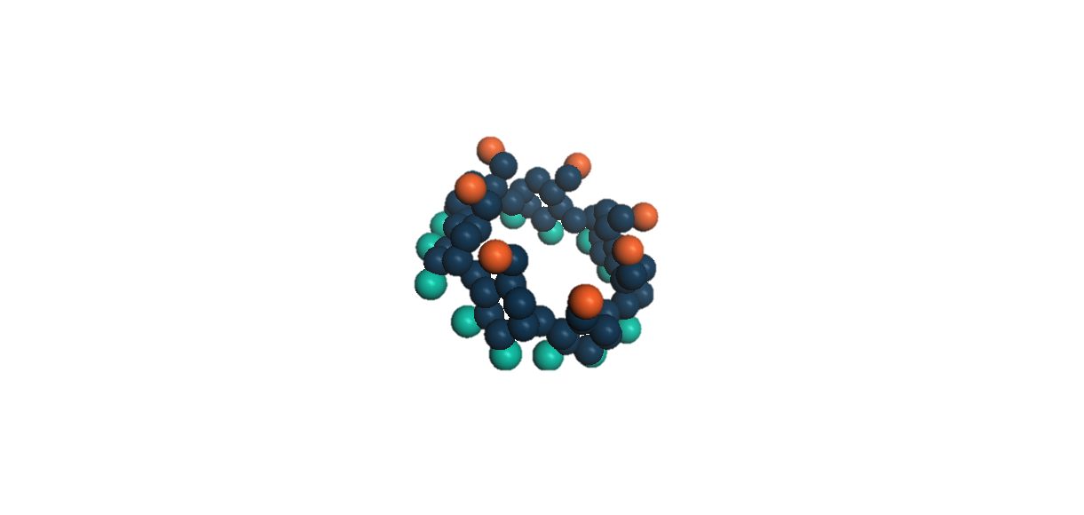
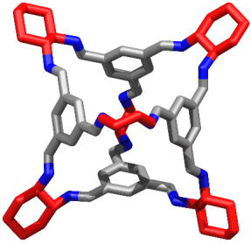
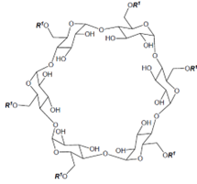
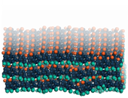
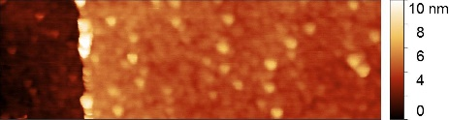




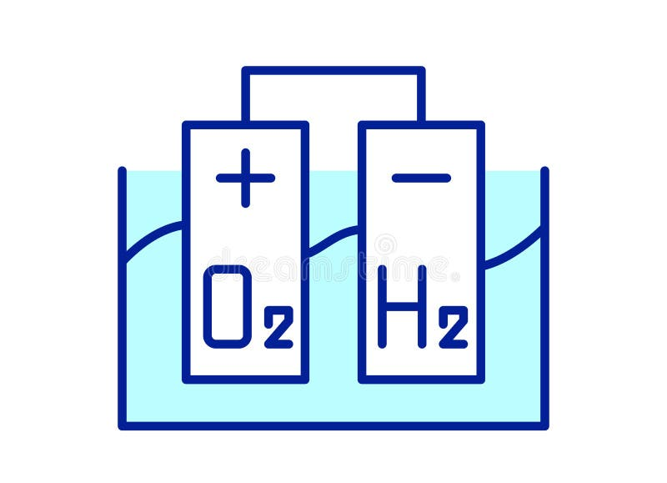


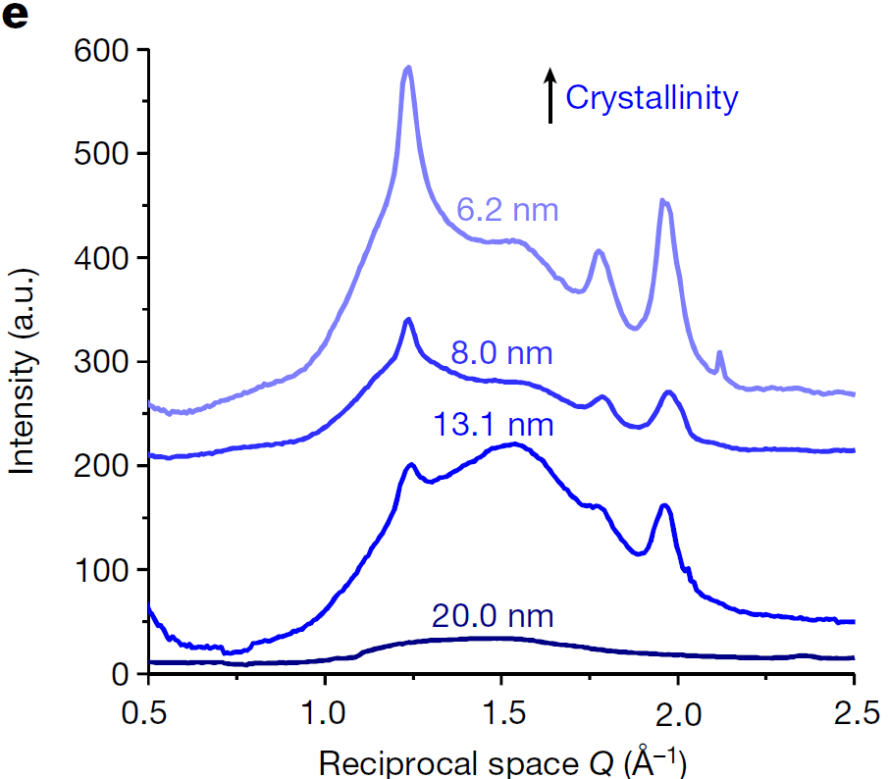
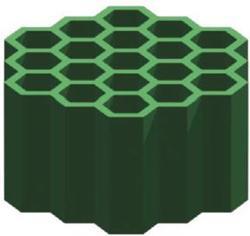
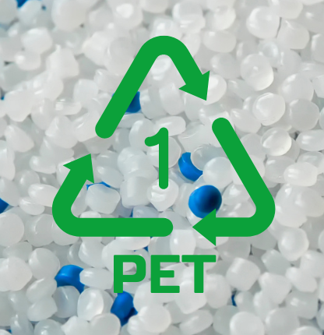

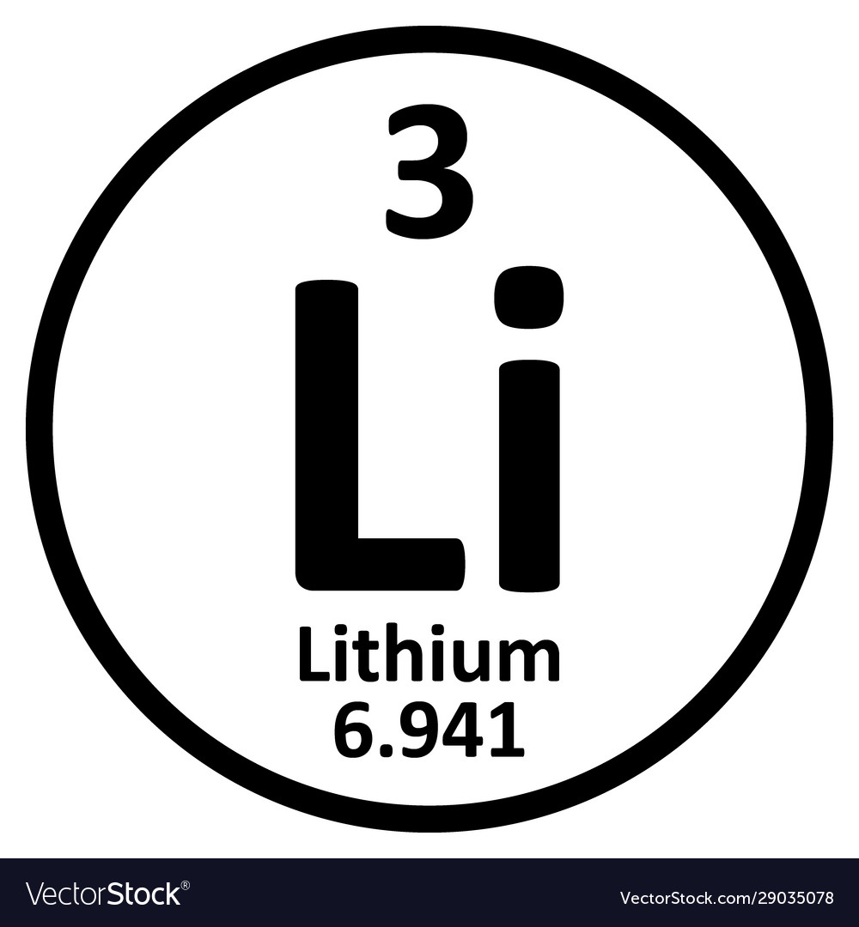
Cavity Design
Membrane Fabrication
Wide Applications
Macrocycle
Interfacial polymerisation
Organic phase
UNIC Membrane
Macrocycle
Cage
COF
Aqueous phase
Ultrathin Nanofilm
Nature 609, 58–64 (2022)
Porous organic cage
Si
Nanofilm
Profile line
200 nm
Biofuel
Pharmaceutical
Catalyst
Nat. Mater. 21, 463–470 (2022)
Aligned interconnected channels
Electrolysis
Battery
Solvent recycle
Covalent organic framework
Xylene production
Crude oil fractionation
Lithium enrichment
Adv. Mater. 36, 2300525 (2024)

